Slide 1


Ionic Pro Overview Training
Government of Canada
19 September 2018

Slide 2

Agenda
Defining terminology
Navigating the dashboard
Organizations and teams
Package
Deploy
Monitoring

Slide 3
Account Structure &
Dashboard Navigation

Slide 4
Objectives
Become familiar with dashboard and major components
Understand the relationship between Ionic Pro’s organizations, teams, members, & apps
Know how to set user permissions to manage your apps

Slide 5
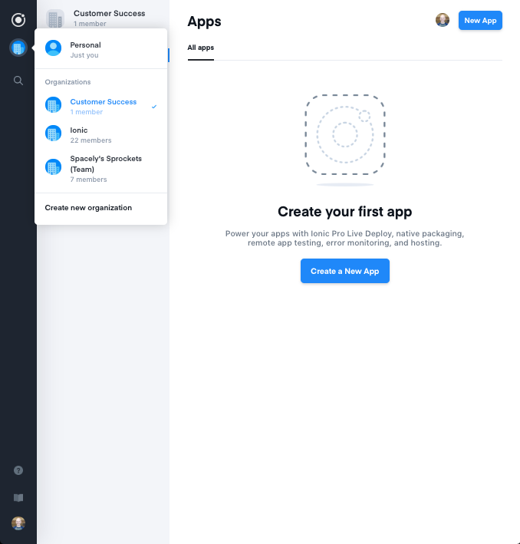
Terminology (1/3)
Workspace
Organization
Account Settings

Slide 6
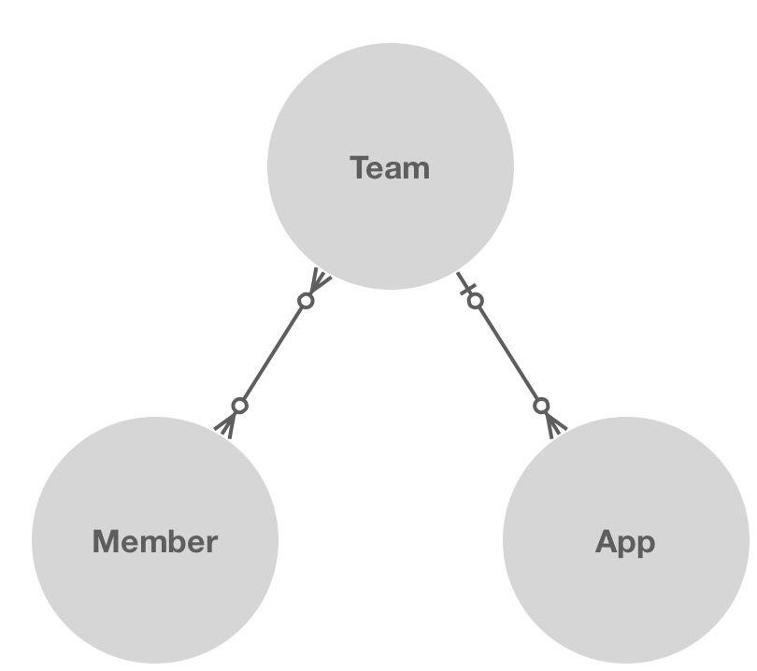
Terminology (2/3)
Team
Roles
Member: Makes functional changes
Admin: Makes permission changes Access app statistics

Slide 7



Terminology (3/3)
Package
Deploy
Live Updates
Monitoring
Type to enter a caption.
Type to enter a caption.

Slide 8
Organization Structure
Apps belong to the organization
Organization(s) comprised of teams
Members must be added to teams to contribute to the app
App inherits features associated with organization

Slide 9
How to Manage Apps & Members
Link an app to Ionic Pro’s organization dashboard
Create a team
Invite members to join new team
Add app to team

Slide 10
Any Questions of Account Overview Topics?
Organization vs. Personal Accounts
Managing access to certain apps

Slide 11
Package
Create Native binaries for iOS and Android in the cloud
Type to enter a caption.

Slide 12
Objectives
Understand how to use Package feature
Learn how to create a Security Profile

Slide 13
Package Initial Set Up Steps
Must create separate profile for Production and Development for both platforms
iOS: Need .p12 and .mobileprovision files for both Development and Production builds
Android: Need .keystore file only for Production builds
Add both platforms before packaging ionic cordova platform add android ionic cordova platform add ios
Push changes to Ionic Pro git add . git commit -m “adding platforms” git push ionic master Enter passkey
Package for Android Debug to witness changes

Slide 14
Package Summary
Initial set up requires most leg work
Create Security Profile
Add platforms to app directory
Package build
Download file and distribute accordingly
Subsequent times only require pushing Package icon next to build

Slide 15
Deploy
Type to enter a caption.
Release hot code changes to devices instantaneously

Slide 16
Objectives
Learn how to set up a channel in Ionic Pro to receive certain updates
Understand different type of updates potentially received
Witness deploy in action

Slide 17
Setting up Deploy
Pro client setup (see https://ionicframework.com/docs/pro/deploy/setup/) npm install @ionic/pro@latest - -save
Choose integration type (Ionic 2/3 or Ionic 1) and edit app.module.ts to contain correct code
Determine deploy strategy for channel. Options are:
Download updates in background, install next time app loads
Download updates in splash screen and install immediately
You manually perform updates in JavaScript (Plugin still required)
Copy/paste code from dashboard to CLI
Push changes to Ionic Pro dashboard
Package build and download to device

Slide 18
Best Practices with Deploy
Removing auto-update for master channel
Deploy > Channels > remove auto update option
Restrict deploy updates by Native Versioning
https://ionic.zendesk.com/hc/en-us/articles/360003567694

Slide 19
Lab: Integrate Ionic Pro
Start using Package, Deploy, and Monitoring

Slide 20
Monitoring
Type to enter a caption.
Pinpoint runtime errors & track to code

Slide 21
Objectives
See capabilities of Monitoring feature
Monitoring pinpoints runtime errors
Can detect in either production or development
See how to sync Source Maps ionic monitoring syncmaps
Advice on using version numbers and organizing commits. Versioning present on:
package.json
config.xml
app.module.ts

Slide 22
Monitoring Summary
Initial setup in tandem with Deploy set up
Ensure versioning is updated with each commit
Sync source maps after each commit
See exactly where the error occurred in Error Monitoring output

Slide 23
Lab: Monitor Errors
Catch errors and pinpoint code location

Slide 24

Questions?
Please don’t ever hesitate to get in touch with us.

